Slide 1

WELCOME TO PINELLAS tELESCHOOL
2025-2026 STUDENT ORIENTATION

Slide 2

General Questions
Thank you
for attending, we are excited to have you here!

Slide 3

General Information
Pinellas Teleschool is a Pinellas County Schools’ Educational Alternative School Disciplinary Site. Teleschool supports students who have been transitioned to a virtual environment as a result of an administrative placement, reassignment, or expulsion. Attendance online by TEAMS is mandatory.
We follow the Pinellas County School Board Policies, including the Code of Student Conduct.
Operating Hours: 7:00 AM-2:30 PM
Student Hours: 7:15 AM-1:45 PM
Serving scholars in grades 6-12
How is Pinellas Teleschool Different?
  Accelerated graduation model.
  Fully staffed student services team with trauma informed care systems.

Slide 4

Full Scale Student Services Support
As an Educational Alternative School (EAS), we support a population of scholars who are 100% trauma-exposed and nearly 90% trauma-engaged. Our typical student is…. A-typical.
To counter environmental and social exposures, we provide many services. Pinellas Teleschool provides a setting that fosters the optimal development of our scholars through connective, empathetic, and communal structures. Some services we provide are:
Onsite social worker, psychologist, behavior specialist & counselor
Clothes for Kids referrals
St. Petersburg Clinic referrals
Free Individual counseling

Slide 5
WHO’S WHO at
Pinellas Teleschool
School Administrators
Etje Ramdohr –Principal
School Instructional Staff
TBA – ESE and 5000 Role Models
Natalee Cleveland – Math 6-8. Algebra 1
Michael Douglas – Science
Alicia Higgins – Math 6-12
Melayna Hunter – Social Studies
Barry Leclair – Digital Info. Tech.
Dainer Simons – English and Lang Arts
Mihailo Stoykovich – Reading
Ms. Savage– MJ Health/Hope
School Support Staff
Rhianna Alejo - Clerk Specialist I
Michelle Ba - Data Management Tech
Coach Blackmon - Behavior Specialist
Melanie Gillett- School Psychologist
Diana Gregory - Secretary/Bookkeeper
Eartha Mims– School Counselor
Devlin Pippert - School Social Worker
Nakkia Sly- Title 1 Coordinator
Cathy Johnson– Registered Nurse
Officer Conyer- S.R.O.
David Willis – Tech Technician
School Paraprofessionals
Shannan Nichols– Attendance

Slide 6
SCHOOL VISION AND MISSION
VISION- 100% student success through a digital learning environment.
MISSION- Pinellas Teleschool’s school mission is to extend educational opportunities beyond the classroom and transcend learning for academic success and life.
MOTTO- Culture to climb, courage to change!

Slide 7
REQUIRED SUPPLIES
All scholars will have access to a PCSB laptop, laptop charger and internet access (Wi-Fi). Daily use of these items is a requirement of enrollment.
Only PCSB laptops and chargers will be permitted inside of the building on testing dates.
Pens, Pencils and paper are given on an as needed basis. Please ask if your student needs them.

Slide 8
Test Day Entry & Release from Disston
School Hours are 7:00 AM-2:00 PM
Testing Hours –
Scholar Entry – Scholars will enter the building through the main entrance.
Parent Drop Off - Please drop your scholar off at the main entrance.
PCSB Laptops- Please bring your PCSB laptop and charger whenever you need to take a test.
Personal items – No backpacks, purses, or clutches. You may bring water and a snack. All items will be searched upon arrival on campus.
Release from testing– All scholars are required to get a Permit to Leave(PTL) by having their parent notify the front reception. All scholars must leave the school campus within 30 minutes of completing testing; otherwise, it will be considered trespassing.
Permits to Leave are granted beforehand, and all scholars, including those over 18, must have parent/guardian notification and/or approval.

Slide 9
Pinellas Teleschool Electronic Device Policy
Scholars may NOT possess a cellular telephone, Smart Watch or other electronic device. Scholars are strongly encouraged to leave cell phones and other electronic devices at home. If it is necessary for a scholar to bring a cell phone to school, the scholar MUST turn in the phone upon entering the building whether they are asked by a staff member or not.
If a scholar is caught with an electronic device, it will be confiscated, and the parent or guardian will have to retrieve the item from school administration.

Slide 10
Electronic Devices Updates from the State of ​
Florida

Slide 11
Florida House Bill 1105 is now in effect, and our district has updated the Code of Student Conduct accordingly. Middle school students are not permitted to use or have visible any cell phone, earbuds, headphones or other wireless devices during the school day (bell to bell). This includes use for instructional purposes, unless specifically allowed under an IEP, 504, medical plan, or emergency situation.

Slide 12
PCSB Medication Guidelines
Scholars may NOT transport medications to or from school.
Parent/Guardian must complete a medication form and/or obtain MD signature/order
Please bring meds to school pre-cut if necessary.
Parents/Guardians must notify the school of any changes in medication dosage, time, etc. (New form must be completed annually)

Slide 13
PCSB Medication Guidelines
Parents are required to pick up and sign out any unused or unnecessary medication at the end of the school year or upon request. (Any medications left at the end of the school year will be destroyed)
Over the counter medications require both a parent signature and written health provider prescription.
Pharmacy label must be intact for prescription meds
Medications MUST be counted with the school nurse upon drop off of the medication as well as the pick-up.

Slide 14
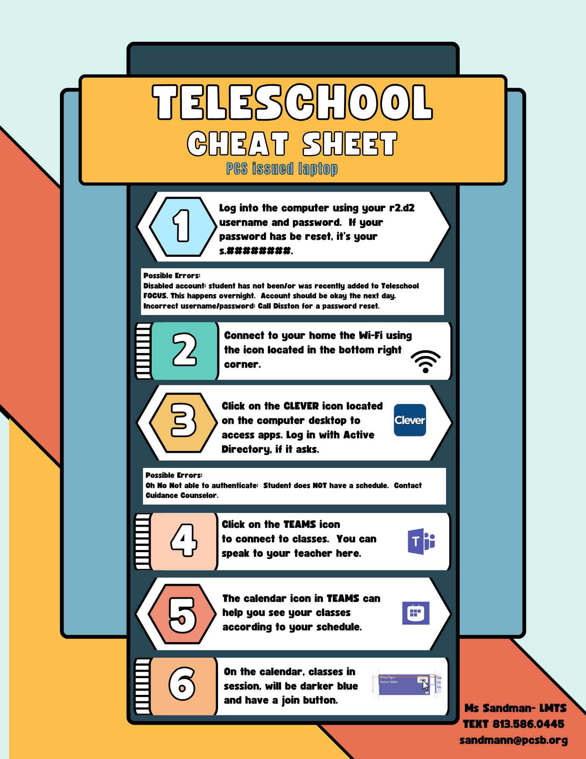



Slide 15
Teleschool Class Schedule Tips
Because Teleschool student classes are scheduled on multiple platforms (Focus, Edmentum and Teams), sometimes students get confused what classes they actually have. For example, Edmentum doesn’t list your full schedule, and the Teams calendar isn’t always perfectly up to date. And the classes listed on the front page of Focus aren’t the full schedule like they are in traditional school.
To see your actual schedule in Teleschool, log into your Focus account (if you don’t have access yet, make sure that your guardian or parent has signed off on the documentation), and click on the Class Schedule tab, and then click on the current semester.

Slide 16
Teleschool Staff Contacts
Below you will find contact information for Teleschool staff. This information may change during the year, it is current for 08/11/2025.
Ms. Simons - simonsda@pcsb.org
Mr. Douglas - douglasmi@pcsb.org
Ms. Higgins - higginsal@pcsb.org
Ms. Hunter - hunterme@pcsb.org
Ms. Hawley –hawleyk@pcsb.org
Ms. Cleveland - clevelandn@pcsb.org
Mr. Leclair - leclairb@pcsb.org
Mr. Stoykovich - stoykovichm@pcsb.org
Ms. Savage- savage@pcsb.org
Dr. Mims, School Counselor - mimse@pcsb.org
Mr. Willis, Tech Specialist for computer and connectivity issues - willisda@pcsb.org
If you have any questions, please don’t hesitate to reach out. We look forward to hearing from you.

Slide 17
Personalized Learning Options
Facilitated Digital Support
100% digital course including assignments, study guides, quizzes & assessments.
Coursework is accessible at anytime, from any web enabled device.
A teacher certified in the content provides support and monitors assessments in person.
Scholars work at their own pace and have the capacity to accelerate and complete courses in less time than a traditional semester model.
Traditional Direct Instruction
Instruction provided through lecture and collaborative structures. (Reading, Crit Think and M/J Health)
Access to laptops and Clever applications for remediation and supplemental support.

Slide 18
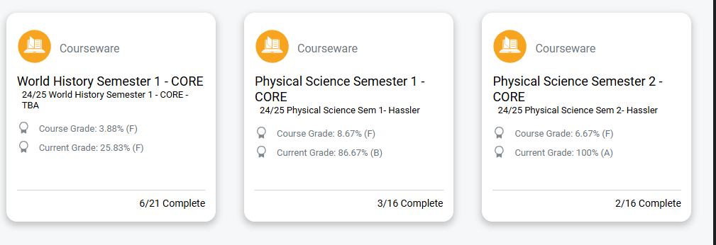
How to Check student progress/Grades

Slide 19
Middle School Promotion Requirements
Pass Three Language Arts Courses
Pass Three Math Courses
Pass Three Social Studies Courses
Pass Three Science Courses ═════════
Complete ELA Assessments
Complete Math Assessments
Complete Grade 8 Science Assessment
Complete Civics Assessment

Slide 20
Graduation Requirements for Both Credit Options
Four (4) Credits of English: English 1, 2, 3, and 4
Four (4) Credits of Math: Algebra 1, Geometry, and two more selected Math credits
Three (3) Credits of Science: Biology and two more selected Science credits
Three (3) Credits of Social Science: World History, US History, Economics (.5), US Govt. (.5)
One Credit of Performing Arts/Practical Arts Credit
Three (3) credits of selected Electives (Reading, Dig Info Tech, Crit Think, etc)
Half credit Personal Financial Literacy (.5)
--------------------------------------------------------------------------------------------------------------------------
The additional requirements for the 24-credit graduation option are:
One Credit of Hope
Five (5) additional selected electives (these should include at least two consecutive credits in the same foreign language IF you wish to enter a university as a freshman, or if you wish to qualify for the highest Bright Futures Scholarship award)
https://www.fldoe.org/schools/k-12-public-schools/sss/graduation-requirements/

Slide 21





Scholars need to pass one of these tests in Reading and Math in addition to earning all their credits to receive a diploma :
Additional Graduation Requirements

Slide 22
Let’s Review the Forms and Policies Together
DIGITAL FORMS IN FOCUS
DOWNLOADABLE FORMS
Clinic Card
Home Language Survey
Network/Internet Acceptable Use Agreement
Media Release
Technology Use Agreement
Consent to Receive Health Services
Directory Information Opt-Out Form
Code of Conduct Acknowledgment Form
Parent/Student Acknowledgment Form
Electronic Device Policy
Safe School Agreement
Where Do I Go for Assistance Form
PCS Student Calendar
Important Parent Notice:
IF YOU DO NOT COMPLETE THESE FORMS
YOU WILL NOT RECEIVE A LAPTOP FOR YOUR STUDENT OR ANY REPAIRS.

Slide 23



HOW CAN PARENTS HELP?
Review your scholar’s progress in each course, current GPA, and past due assignments.
Contact your scholar’s teacher if you suspect they may be off track.

Slide 24
PARENT CONFERENCES
Parent-scholar conferencing is highly recommended. This conference can occur via Microsoft TEAMS or telephone conferencing.
Arrangements can sometimes be made after hours on designated nights.
While it is always encouraged to communicate with individual teachers. Please contact Dr. Mims to set up a conference when necessary.
Parents may be required to attend conferences to address significant concerns with placement, attendance, or academic progress.

Slide 25
*** Digital Info Tech (aka BusInfoMgmt on Edmentum) is an Independent Study class. There are NO TEAMS meetings. If students log in to the Edmentum and work for about 30 minutes each school day you will be marked present. Mr. LeClair recommends spending about 20 minutes on the Tutorials and 10 minutes on the Mastery Test quizzes. The best way to reach Mr. LeClair is via the Message feature in Edmentum.
Students can also work evenings and weekends if they want to get ahead in any class.

Slide 26
